Slide 1
PCA9557: REMOTE 8-BIT I²C AND SMBus LOW-POWER I/O EXPANDER

Slide 2
Reference Books
REMOTE 8-BIT I2C AND SMBus LOW-POWER I/O EXPANDER WITH RESET AND CONFIGURATION REGISTERS

Slide 3
Chip Description and Key Features
8-bit I/O expander for I²C bus
I²C to parallel port expander
400-kHz fast I²C bus
3 hardware address pins allow for use of up to 8 devices on I²C
Noise filter on SCL/SDA inputs
General-purpose remote I/O expansion for most microcontroller families
At power on, the I/Os are configured as inputs
The I/Os can be programmed by I²C master to be as either inputs or outputs
Latched outputs with high current drive maximum capability for directly driving LEDs
Data for each input or output is kept in the corresponding input or output register
The polarity of the input port register can be inverted with the polarity inversion register

Slide 4
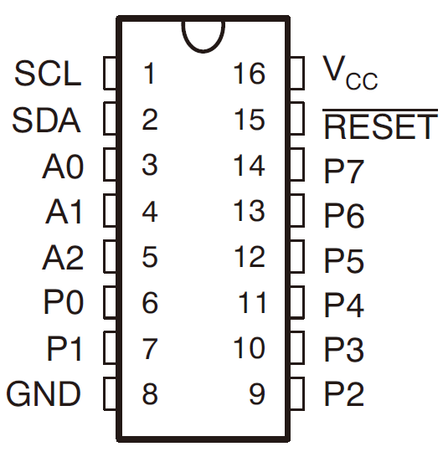
Package & Pins
Top-side marking: PD557

Slide 5
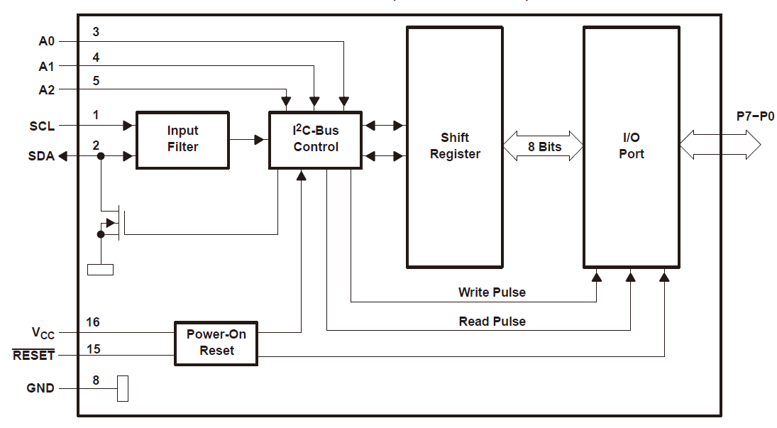
Logic Diagram

Slide 6
I²C Protocol Review
Two lines: the serial clock (SCL) and serial data (SDA)
Connected to a positive supply through a pull-up resistor
Communication is initiated by a master sending a start condition
A high-to-low transition on the SDA & the SCL input is high
After the start condition, the device address byte is sent
Most-significant bit (MSB) first
Followed by the data direction bit (R/W)
After receiving the valid address byte, the device having this address responds with an ACK
A low on the SDA during the high of the ACK-related clock pulse

Slide 7
I²C Protocol Review Cont.
Data transfer begins
Only one data bit is transferred during each clock pulse
Any number of data bytes can be transferred from the transmitter to the receiver
Each byte of eight bits is followed by one ACK bit
The transmitter must release the SDA line
The receiver must pull down the SDA line during the ACK clock pulse
Master will stop the transmission by issuing a stop condition
A low-to-high transition on the SDA & the SCL input is high

Slide 8
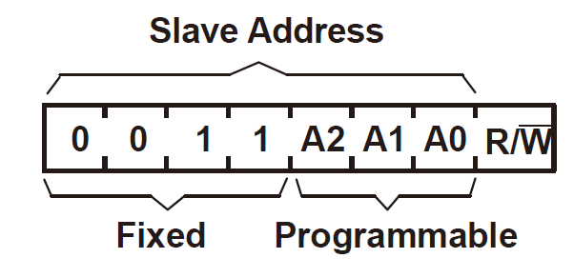
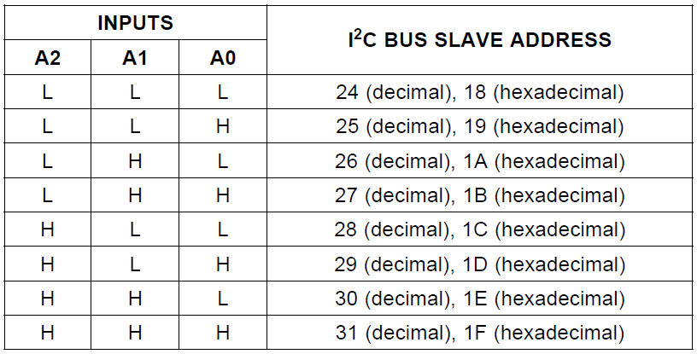
Device Address
The address of the PCA9557 is shown as follows
R/~W: a high (1) indicates a read operation,
while a low (0) selects a write operation.

Slide 9
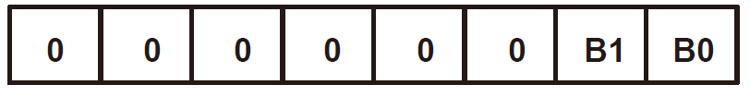

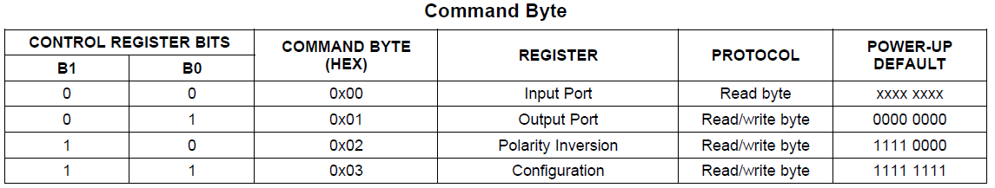
Control Register & Command Byte
After the successful ACK of the address type, the bus master sends a command byte that is stored in the control register in the PCA9557
Command bytes are used to specify the operation and the internal registers that will be affected

Slide 10
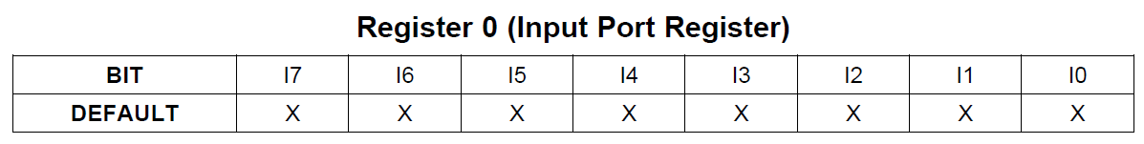
Input Port Register
Reflects the incoming logic levels of the pins
All pins no matter whether a pin is an input or an output
The default value is determined by the externally applied logic level

Slide 11
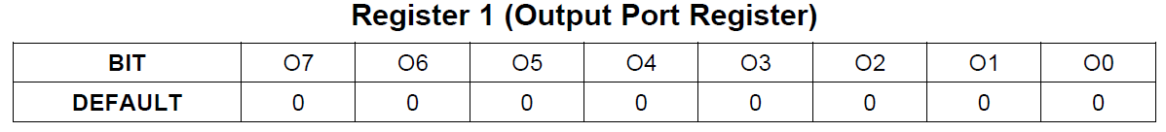
Output Port Register
Shows the outgoing logic levels of the pins defined as outputs
Bit values in this register have no effect on pins defined as inputs
reads from this register reflect the value that is in the flip-flop controlling the output selection, not the actual pin value

Slide 12
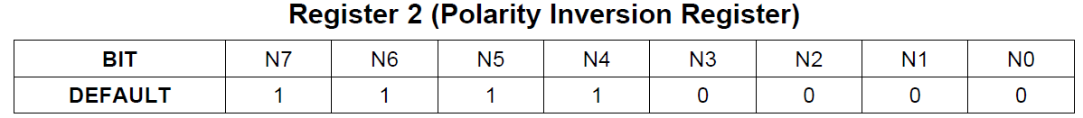
Polarity Inversion Register
Inverts the polarity of input pins
If a bit in this register is set, the corresponding port pin's polarity is inverted
If a bit in this register is cleared, the corresponding port pin's original polarity is retained

Slide 13
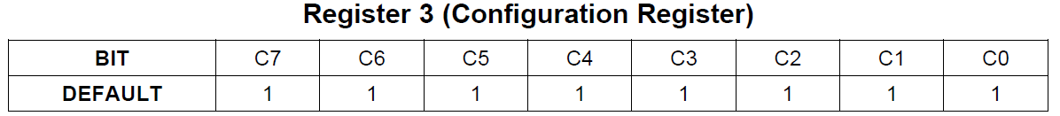
Configuration Register
Configures the directions of the I/O pins
If a bit in this register is set to 1, the corresponding port pin is enabled as an input
If a bit in this register is cleared, the corresponding port pin is enabled as an output

Slide 14
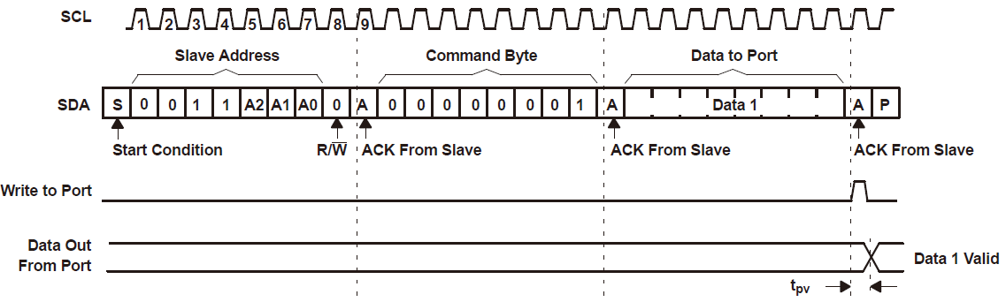
Write Operation

Slide 15
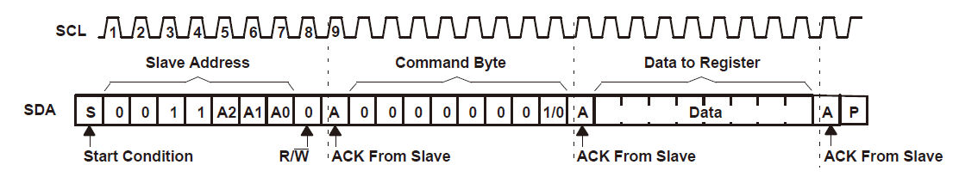
Write Operation

Slide 16
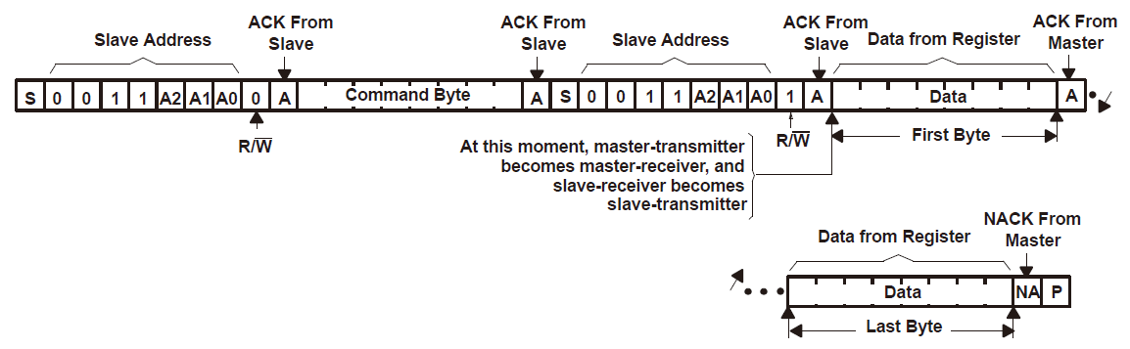

Read Operation

Slide 17
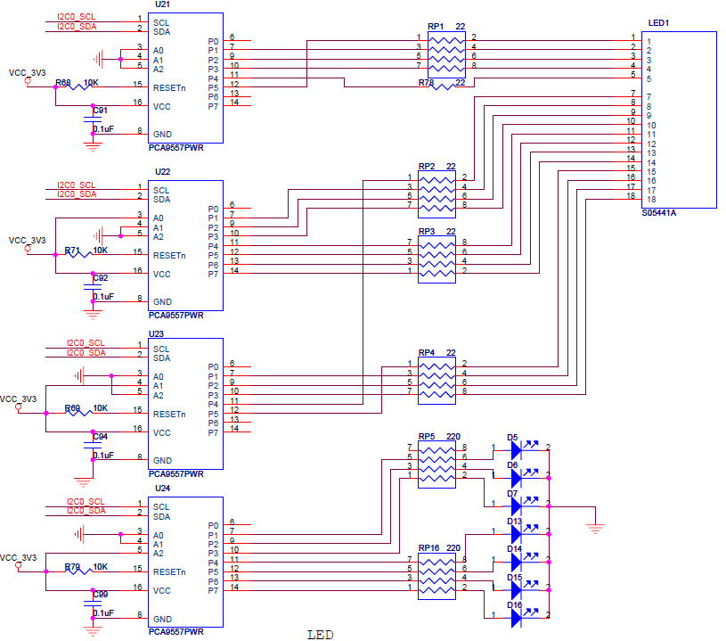
I²C on S700

Slide 18
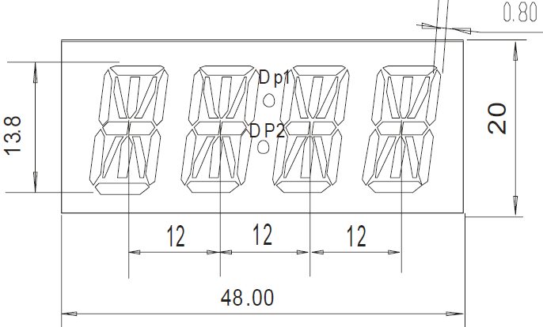
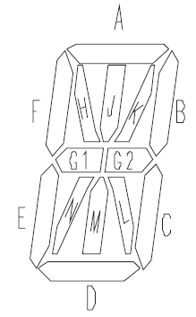
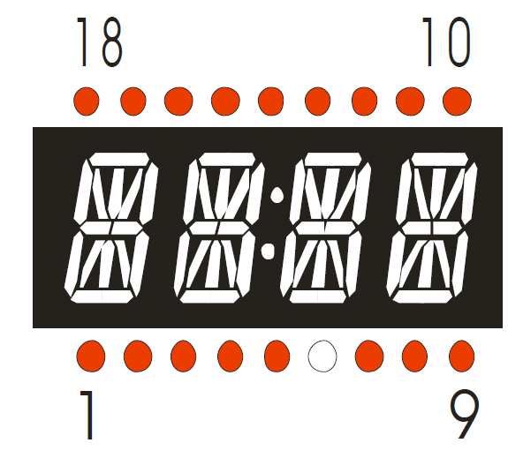
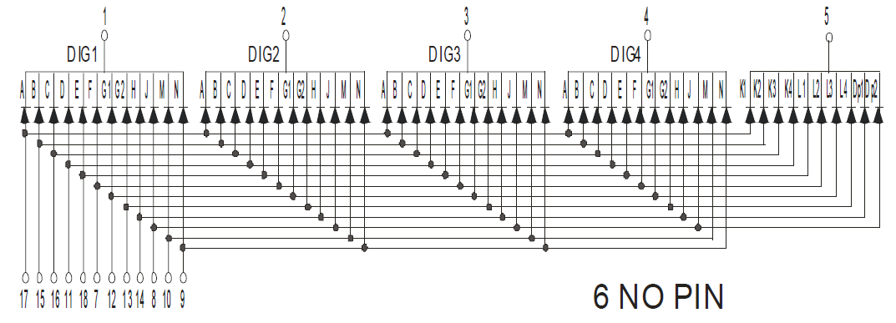

Digital LED Tubes on S700

